Slide 1
FHIR: EHR Data Sharing
Courtesy: Dr. Darrell Woelk from Greenwood Technologies

Slide 2








Problem: Limited Healthcare Data Interoperability
Me
My
Doctor
Cerner
EHR
Epic
EHR
Aetna
Clinic
Cigna
Hospital
Patient Data
(My Data)
Patient Data
(My Data)
Patient Data
(My Data)
Patient Data
(My Data)
Health Information
Exchange

Slide 3

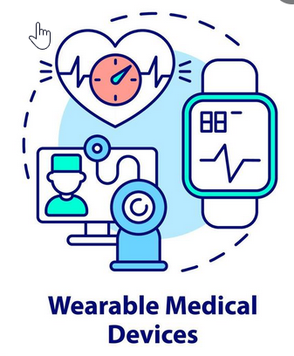
Solution: FHIR Enabled Healthcare Data Interoperability
In the US, the recent 21st Century Cures Act requires EHR vendors to support access to a subset of patient data via an HL7 FHIR API
Me
My
Doctor
Third Party Apps
(SMART on FHIR)
(CDS Hooks)
FHIR
FHIR
FHIR
Cerner
EHR
Epic
EHR
Aetna
Clinic
Cigna
Medical
Devices
Hospital
Patient Data
(My Data)
FHIR
Patient Data
(My Data)
Patient Data
(My Data)
FHIR
Patient Data
(My Data)
FHIR
FHIR
Health Information
Exchange

Slide 4
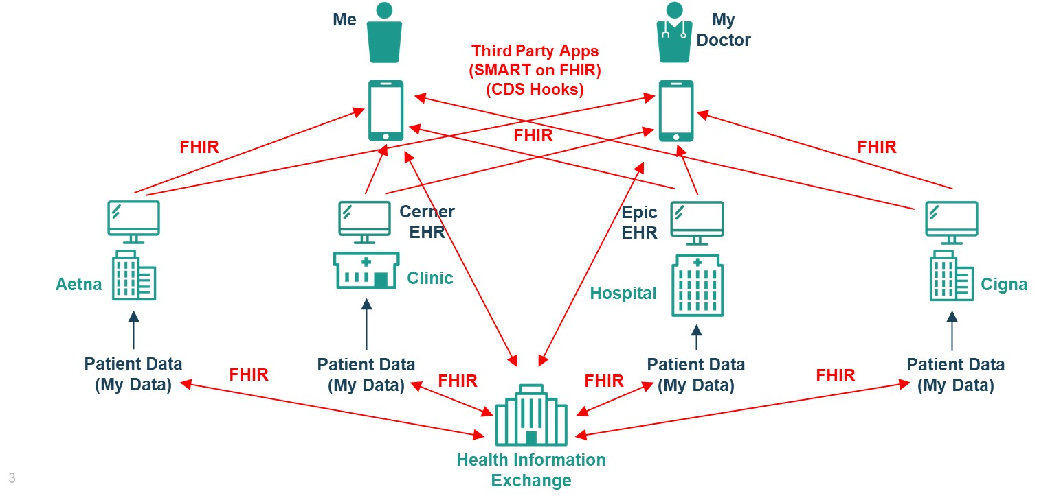
TEFCA Data Exchange Using FHIR
TEFCA QHIN
TEFCA QHIN
TEFCA Broker
ONC Trusted Exchange Framework and Common Agreement (TEFCA) includes a FHIR® Roadmap for TEFCA Exchange that defines Stages for network-facilitated and network-brokered exchange of FHIR data
https://rce.sequoiaproject.org/wp-content/uploads/2022/01/FHIR-Roadmap-v1.0_updated.pdf
TEFCA QHIN

Slide 5
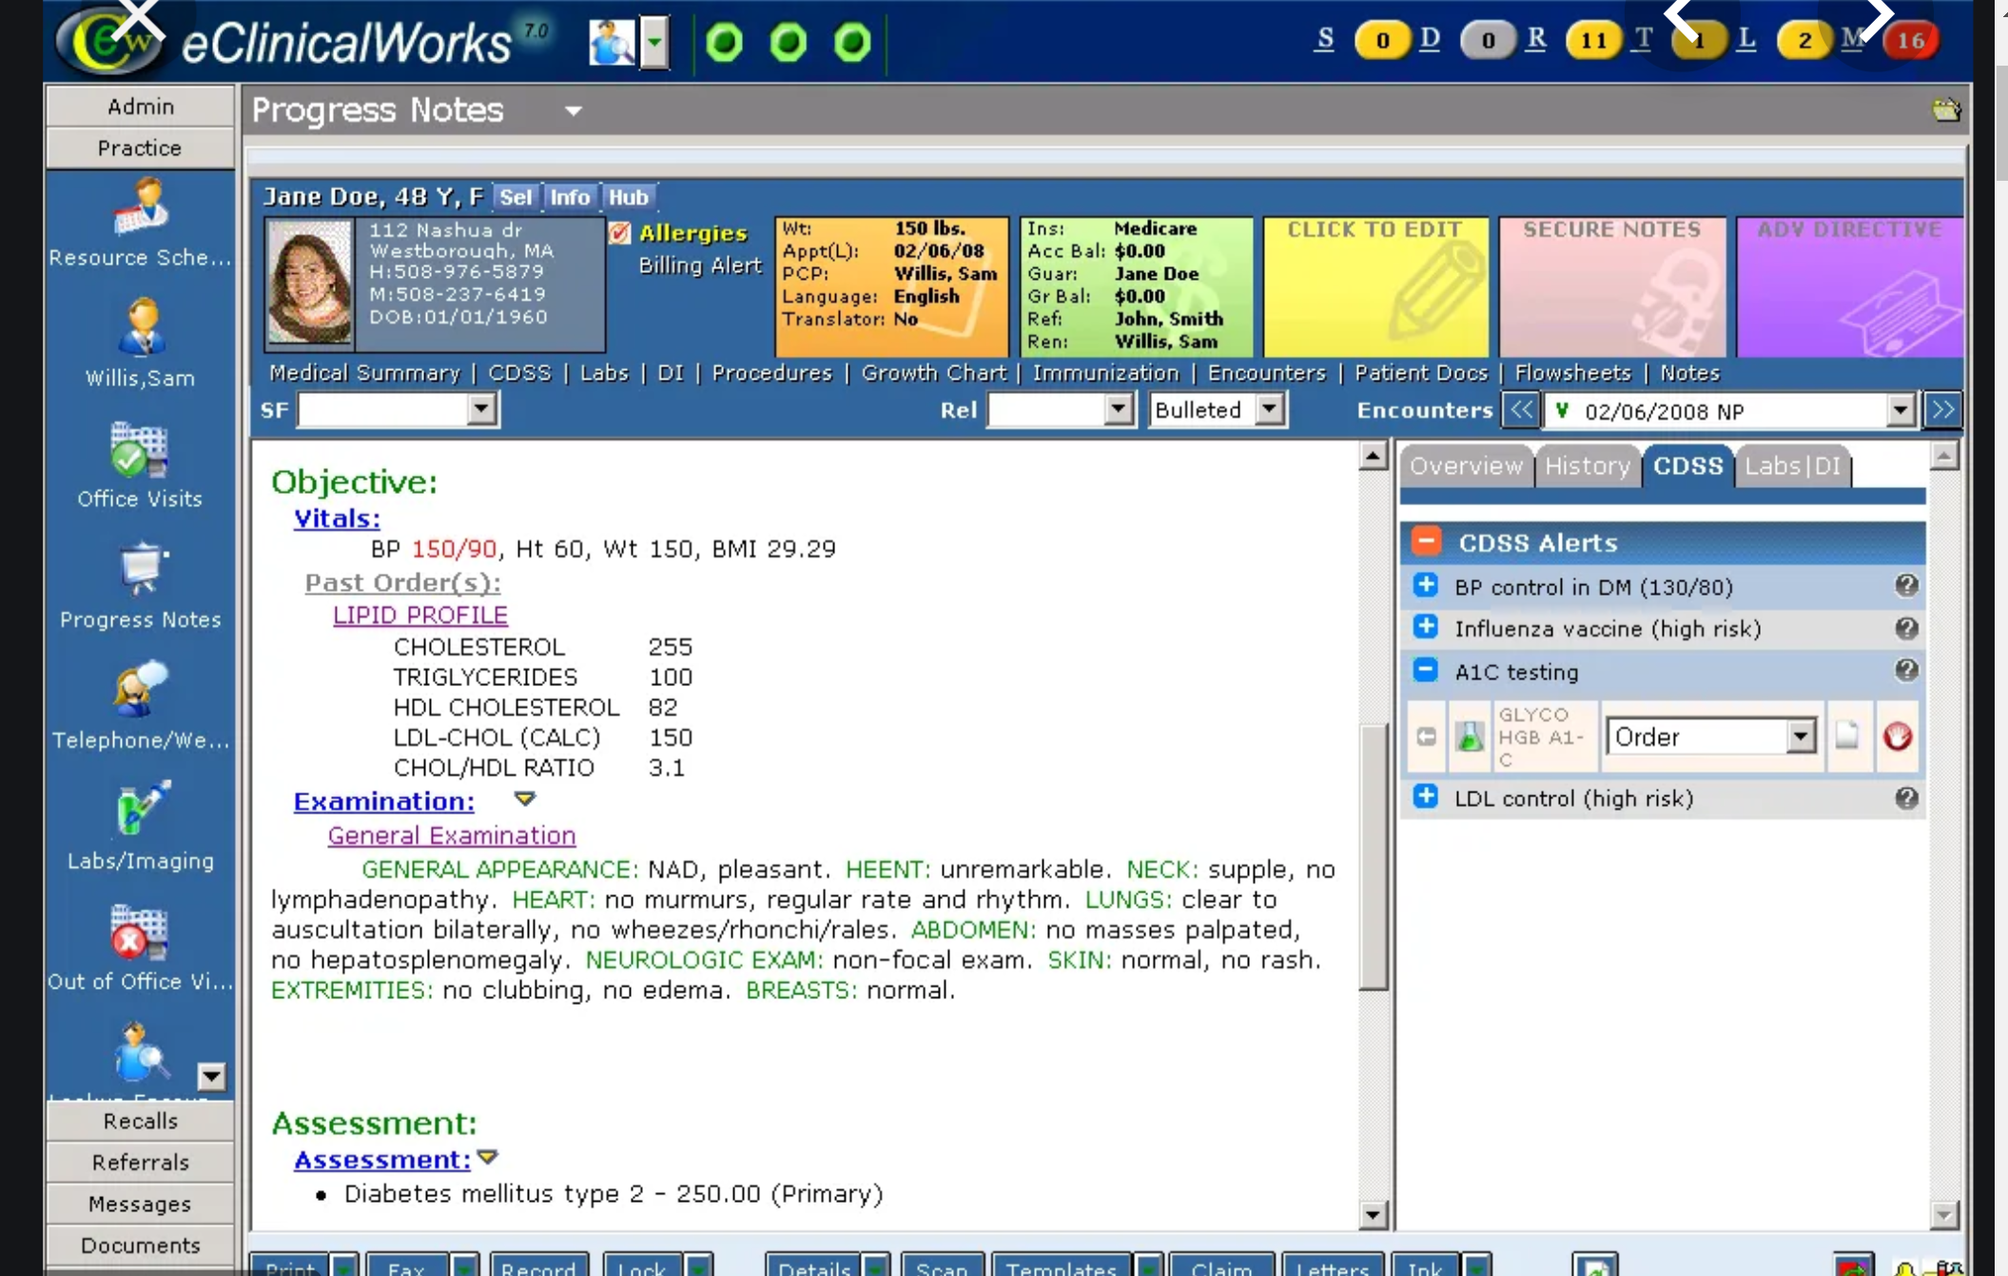
Sample EHR Screen
Demographics
& History
EHR
Functions
SMART
on FHIR
App
Can Display
Here
Today’s
Visit

Slide 6
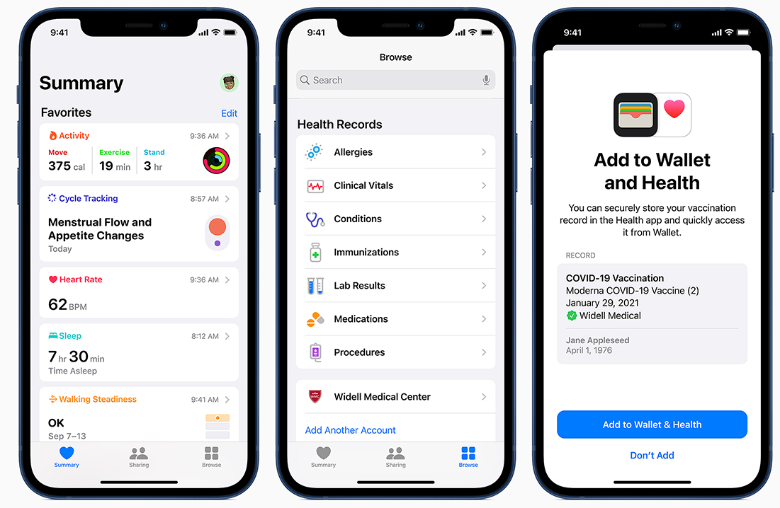
Sample iPhone Health Screens
FHIR Data
from
Widell Medical Center
Verified
FHIR Vaccination Report
from
Widell Medical Center
Sleep
Monitor
Add FHIR Data
From
Another Provider
https://www.apple.com/ca/healthcare/health-records

Slide 7
FHIR Interoperability Standards Ecosystem
US Government
Agencies
ONC
Coordinate Exchange
of Healthcare Data
CMS
Administer Medicare, Medicaid
CHIP, Insurance Marketplaces
Set Interoperability Rules
FHIR
Taskforces
Investigate
Scalability of FHIR Deployment
ONC FHIR at Scale Taskforce
FHIR
Accelerator
Projects
Create FHIR Implementation Guides for Use Cases
Argonaut
Da Vinci
CARIN
CodeX
Gravity
Vulcan
Helios
Industry
Standards
Organizations
IHE
IEEE
DICOM
OMG
Create
Base Standards
HL7

Slide 8
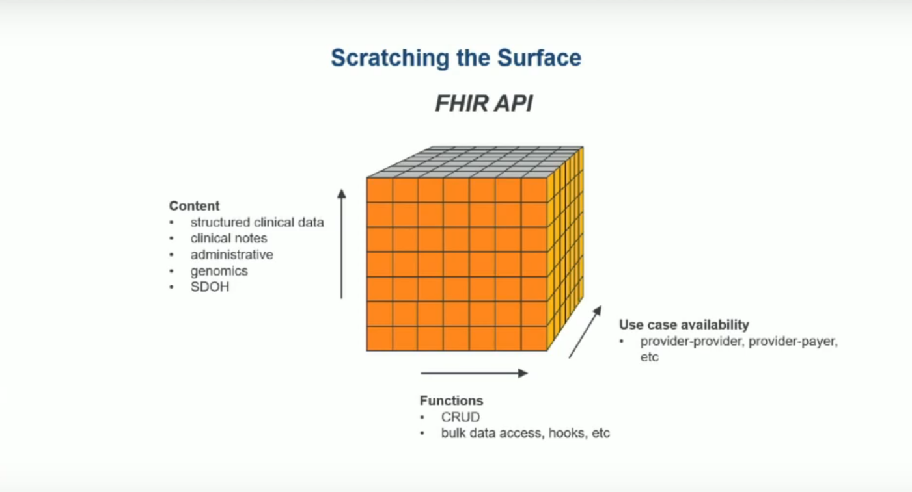
Scope of the FHIR Standard
FHIR DevDays 2020 Keynote - Micky Tripathi: https://www.youtube.com/watch?v=vcJ03RxE84U

Slide 9
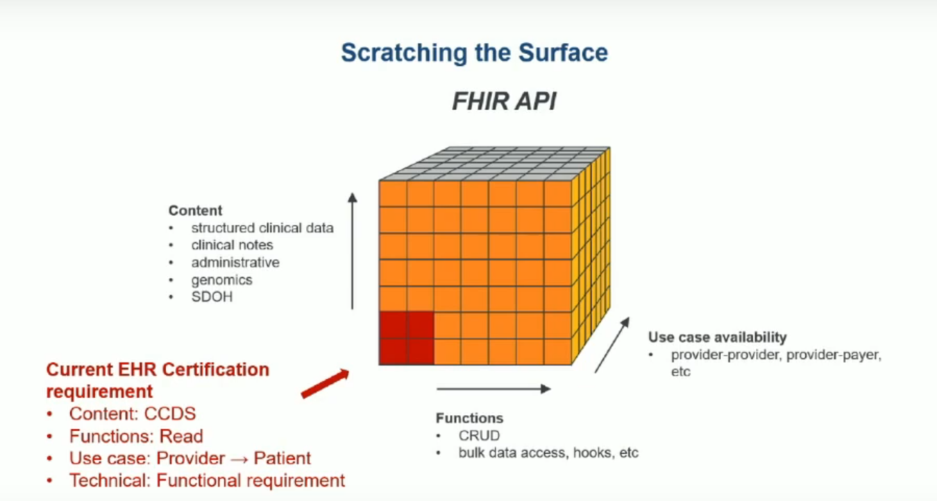
Scope of the ONC/CMS Rules
Create / Update Registry Definition (CURD)
USCDI
Provider -> Patient,
Payer -> Patient
Adapted from FHIR DevDays 2020 Keynote - Micky Tripathi: https://www.youtube.com/watch?v=vcJ03RxE84U

Slide 10
HL7 FHIR Accelerator Projects
Argonaut Project (EHR Patient Data)
Gravity Project
(Social Determinants of Health Data)
Me
My
Doctor
PACIO Project
(Long-Term Post-Acute Care)
Third Party Apps
(SMART on FHIR)
(CDS Hooks)
CARIN Project
(Payer Claims Data)
CodeX Project
(Cancer Data)
FHIR
FHIR
FHIR
FHIR
Vulcan Project
(Clinical Research Data)
Cerner
EHR
Epic
EHR
Helios Project
(Public Health)
Aetna
Clinic
Cigna
Hospital
Patient Data
(My Data)
FHIR
Patient Data
(My Data)
Patient Data
(My Data)
FHIR
Patient Data
(My Data)
FHIR
FHIR
Health Information
Exchange
DaVinci Project
(Payer Claims & EHR Patient Data)

Slide 11
So, What is FHIR?
Fast Healthcare Interoperability Resources (FHIR) is an international standards framework for the exchange of healthcare data
FHIR solutions are built from a set of modular components called "Resources".
Resources can easily be assembled into working systems that solve real world clinical and administrative problems at a fraction of the price
FHIR is suitable for use in a wide variety of contexts – mobile apps, cloud communications, HER data sharing, server communication in large institutional healthcare providers, and much more.
Database servers have been developed that support creating, retrieving and searching for FHIR resources

Slide 12
Use Case: FHIR Resources for Patient Visit
Practitioner
performer
participant[0].individual
Observation
asserter
code.coding[0].system = http://loinc.org
code.coding[0].code = 8867-4
code.coding[0].display = Heart rate
valueQuantity.value = 44
encounter
Encounter
encounter
Condition
subject
code.coding[0].system = http://snomed.info/sct
code.coding[0].code = 312824007
code.coding[0].display = Family history of
cancer of colon
subject
subject
Patient
id = example
name.given = Tina
name.family = Test

Slide 13
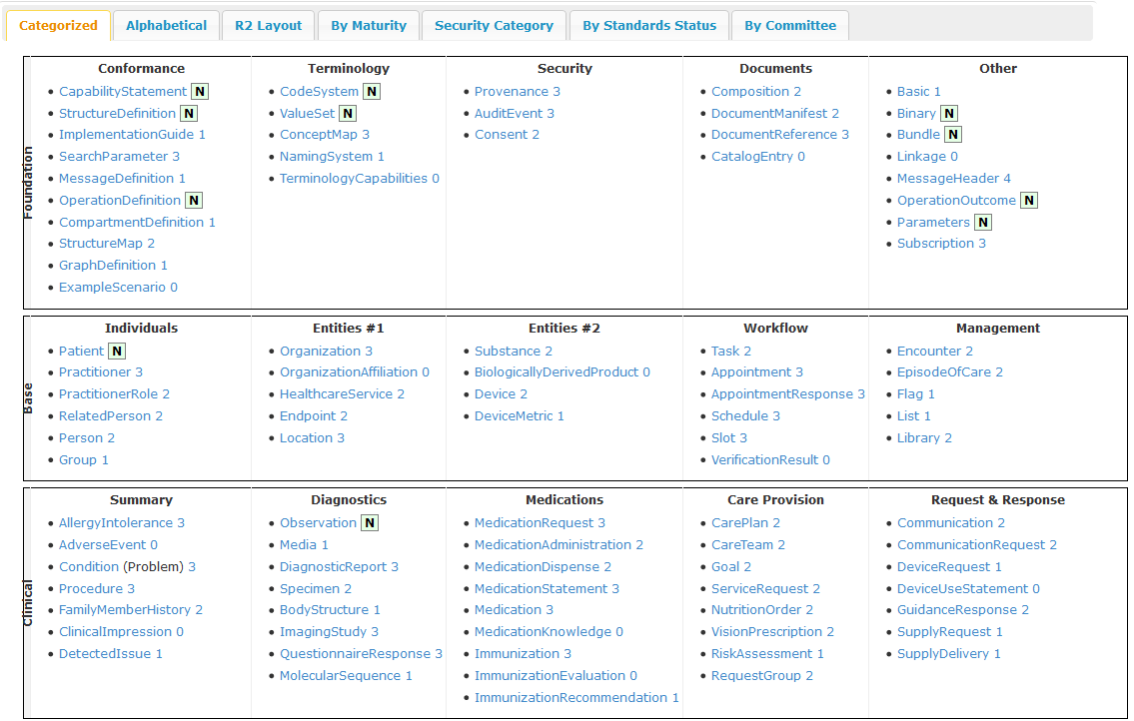
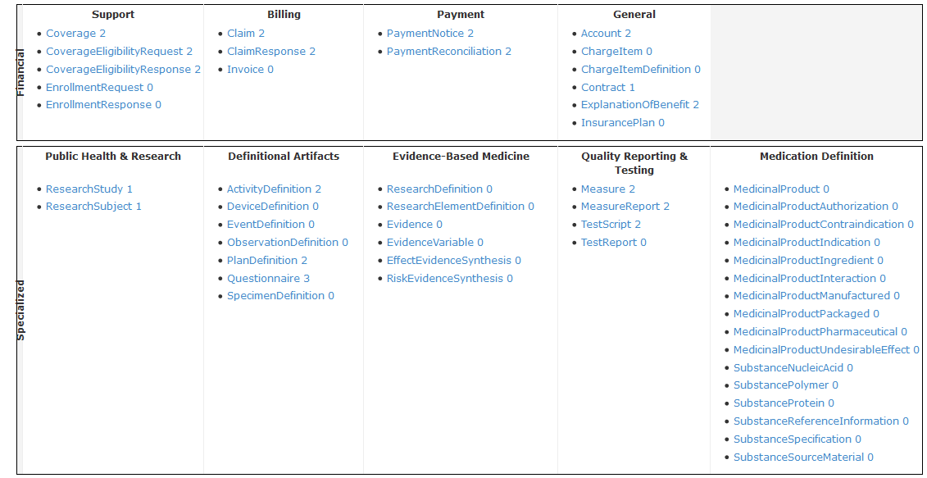
FHIR Resources
Categories of FHIR Resources
Foundation
• Conformance
• Terminology
• Security
• Documents
• Other
Base
• Individuals
• Entities #1
• Entities #2
• Workflow
• Management
Clinical
• Summary
• Diagnostics
• Medications
• Care Provision
• Request & Response
Financial
• Support
• Billing
• Payment
• General
Specialized
• Public Health & Research
• Definitional Artifacts
• Evidence-Based Medicine
• Quality Reporting & Testing
• Medication Definition
Observation
Resource
https://www.hl7.org/FHIR/resourcelist.html

Slide 14
What’s a Resource?
Examples
Administrative
Patient, Practitioner, Organization, Location, Coverage, Invoice
Clinical Concepts
Allergy, Condition, Family History, Care Plan
Infrastructure
Document, Message, Profile, Conformance
Non-examples
Gender
Too small
Electronic Health Record
Too big
Blood Pressure
Too specific
Intervention
Too broad
100-150 total - ever

Slide 15

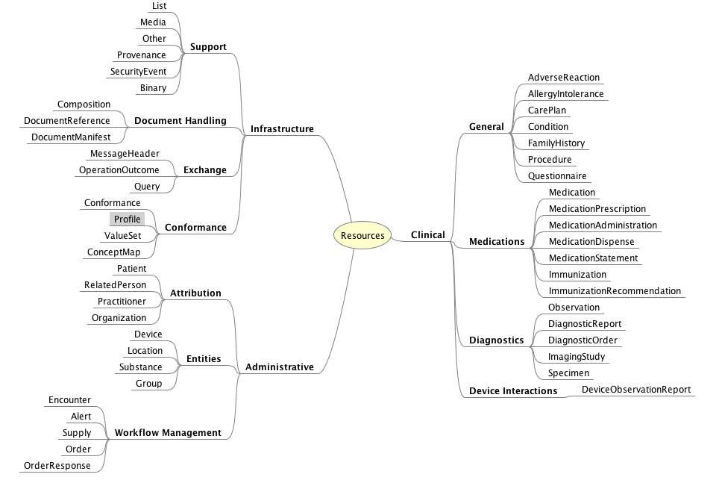
Resource List

Slide 16
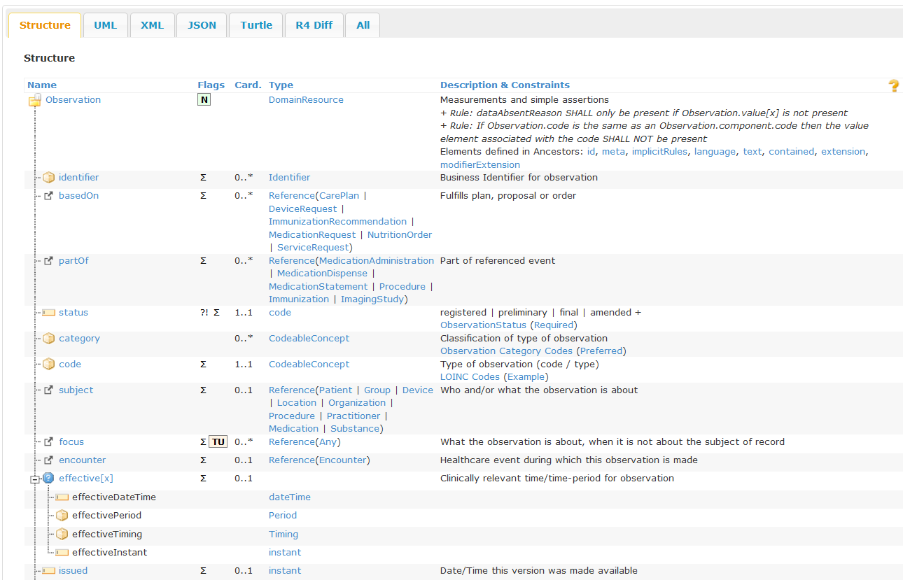
Structure of the FHIR Observation Resource

Slide 17
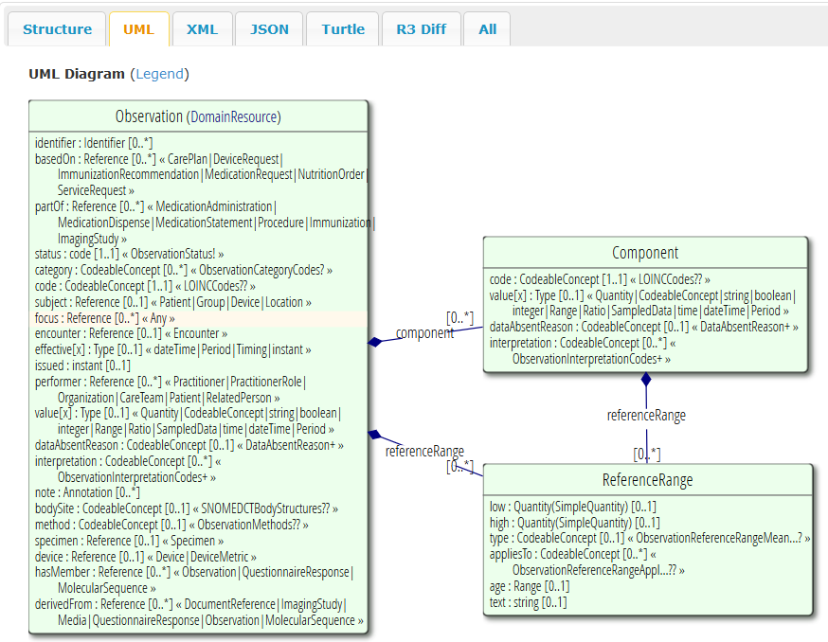
UML for FHIR Observation Resource
Reference to
Patient Resource
Reference to
Encounter Resource
Reference to
Practitioner Resource
https://www.hl7.org/FHIR/observation.html

Slide 18
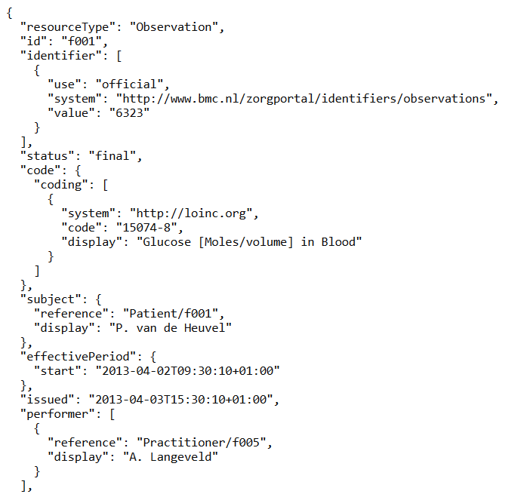
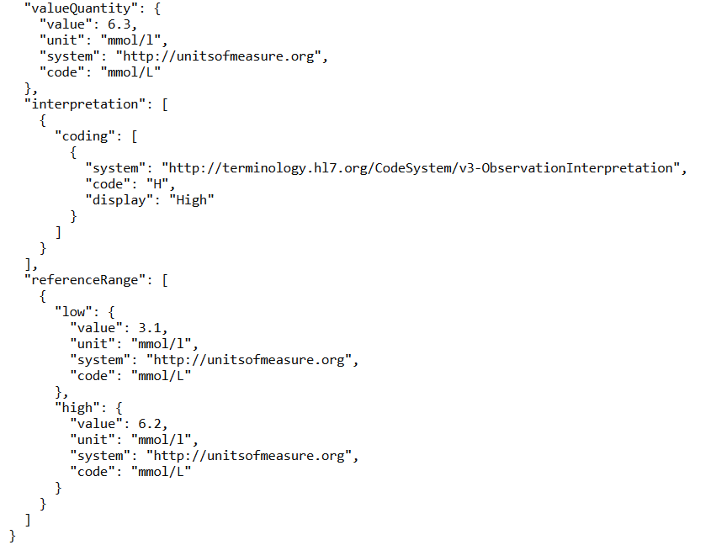
Example of FHIR Observation Resource for Glucose
(JSON Format)
https://www.hl7.org/FHIR/observation-example-f001-glucose.html

Slide 19
FHIR Search Command
https://www.hl7.org/fhir/search.html
Searching for resources is fundamental to the mechanics of FHIR. Search operations traverse through an existing set of resources filtering by parameters supplied to the search operation.
FHIR Search Syntax
The client requests data using the following HTTP syntax:
GET [baseUrl]/[resourceType]?[optional parameters]
The server then returns a FHIR Bundle resource, which is a container resource containing the matching search results
Example:
https://r4.smarthealthit.org/Observation?code=2339-0

Slide 20
Search Using a Reference Between Resources
Get the Observation resources with Triglycerides values for the Patient with id = 0e61c3ad-d11e-4080-a6aa-cac89cae4e37
https://r4.smarthealthit.org/Observation?subject=Patient/0e61c3ad-d11e-4080-a6aa-cac89cae4e37&code=2571-8
https://r4.smarthealthit.org/Observation?subject=Patient/0e61c3ad-d11e-4080-a6aa-cac89cae4e37&code=2571-8

Slide 21
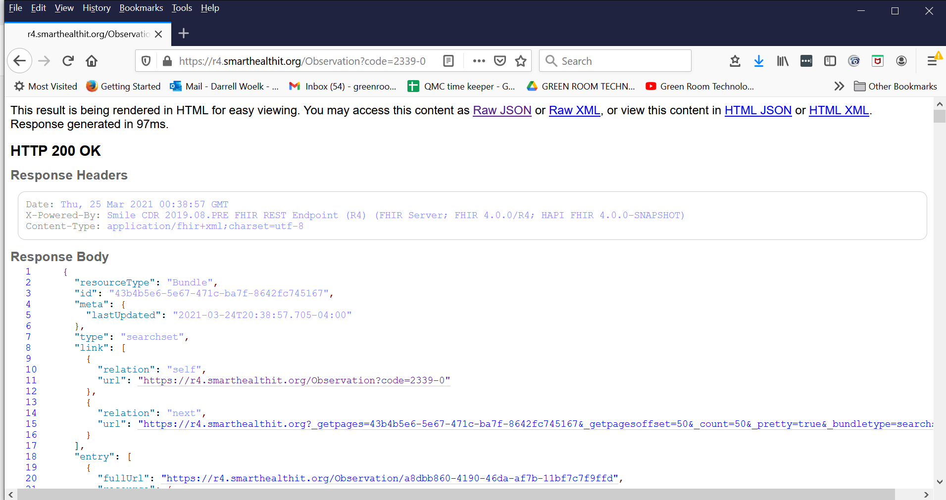
Execute a FHIR API Call in a Browser: https://r4.smarthealthit.org/Observation?code=2339-0

Slide 22
Architecture for FHIR Applications
R App
App
Python
App
Java
App
JavaScript
App
SMART on FHIR
App Galleries
R
FHIR Library
Python
FHIR Library
Java
FHIR Library
JavaScript
FHIR Library
FHIR REST API
SMART on FHIR API
CDS Hooks API
FHIR Bulk Data Access API
Public Test
FHIR Servers
Commercial
FHIR Servers
Health Insurance with FHIR API
EHR’s
with FHIR API
29 Public Test FHIR Servers
Google
Microsoft
IBM
Health Samurai
1UpHealth
SmileCDR
…..
Anthem
Blue Cross Blue Shield
Cigna
Humana
United
…..
Epic
Cerner
Allscripts
athenahealth
….

Slide 23
Open Source and Commercial FHIR Servers
There are 29 public FHIR Test Servers online for use in application development and for testing at FHIR Connectathons
https://confluence.hl7.org/display/FHIR/Public+Test+Servers
Logica Health provides a personal instance of a FHIR Server for testing FHIR applications
https://www.logicahealth.org/solutions/fhir-sandbox/
There are a number of commercially supported FHIR Servers from small companies along with software tools for application development
1UpHealth (https://1up.health/)
Health Samurai (https://www.health-samurai.io/)
Smile CDR (https://smilecdr.com/)
Vonk FHIR Server (https://vonk.fire.ly/)
and others …..

Slide 24
FHIR and the Major Technology Companies
The Argonaut Project was formed by the major EHR vendors in 2014 to set priorities and write Implementation Guides for using FHIR
https://confluence.hl7.org/display/AP/Argonaut+Project+Home
Apple Health Records iPhone app is able to access a user’s selected medical records from provider organizations using the FHIR API
https://www.apple.com/healthcare/health-records/
Microsoft has announced the Azure API for FHIR product that is a managed Platform-as-a Service (PaaS) cloud offering that is built on an open source FHIR server based on the Azure Cosmos DB
https://azure.microsoft.com/en-us/services/azure-api-for-fhir/
Google has announced the Cloud Healthcare API PaaS which includes a FHIR database
https://cloud.google.com/healthcare/
The IBM Watson for Health GxP PaaS includes a FHIR database and is able to import healthcare data from other sources
https://www.ibm.com/products/fhir-server

Slide 25
The Evolving FHIR Ecosystem
Improved Clinical Efficacy
Machine Learning
FHIR RDF
FHIR Bulk Data Access
Increased
Knowledge
Sharing
SMART Health Card
HL7 CQL
CDS Hooks
SMART on FHIR
HL7 FHIR
Improved Clinical Efficiency
Increased
Data
Sharing

Slide 26
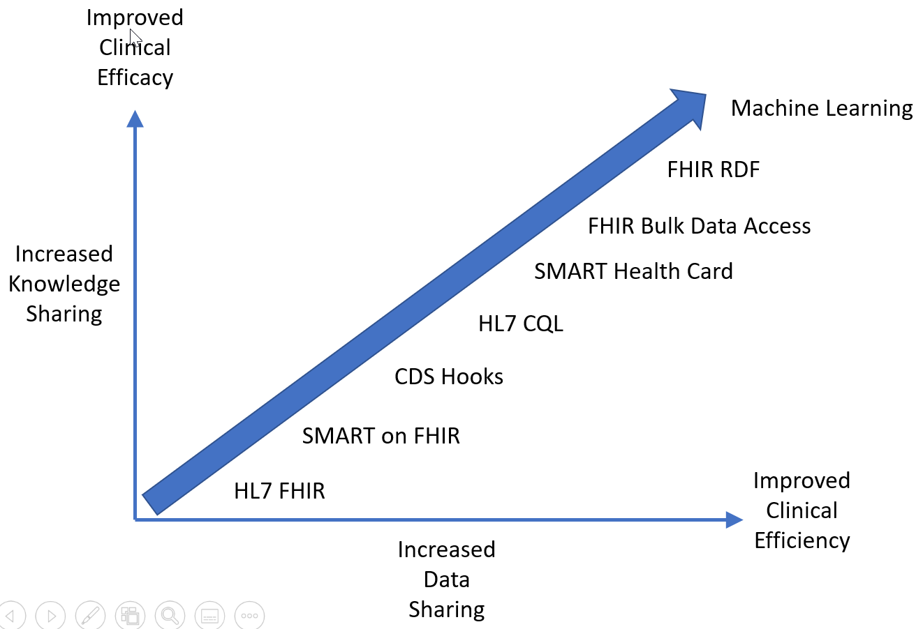
Improving Clinical Efficacy with FHIR
The HL7 FHIR (Fast Healthcare Interoperability Resources) standard defines a set of Resources and a REST API for creating, retrieving, searching, and updating
https://www.hl7.org/fhir/
The SMART on FHIR specification defines a framework for launching FHIR-based apps from an EHR that leverages OAuth2 and OpenID for authorization and authentication
https://smarthealthit.org/
The CDS Hooks specification defines a framework for registering and launching Clinical Decision Support apps from an EHR at specific points in the clinical workflow
https://cds-hooks.org/
HL7 Clinical Quality Language (CQL) is a high-level, domain-specific language focused on clinical quality and targeted at quality measure and decision support artifact authors
https://ecqi.healthit.gov/cql

Slide 27
Improving Clinical Efficacy with FHIR
SMART Health Cards are verifiable paper or digital versions of FHIR clinical data that implement the W3C Verifiable Credentials standard to prove the authenticity of the data
https://smarthealth.cards/en/
FHIR Bulk Data Access provides an API for transferring large amounts of FHIR data
https://hl7.org/fhir/uv/bulkdata/
FHIR RDF is an RDF representation of FHIR resources for knowledge applications that is an alternative to the XML and JSON representations
https://www.hl7.org/fhir/rdf.html
Machine Learning can be used to train models that identify patterns in FHIR data that predict health outcomes

Slide 28
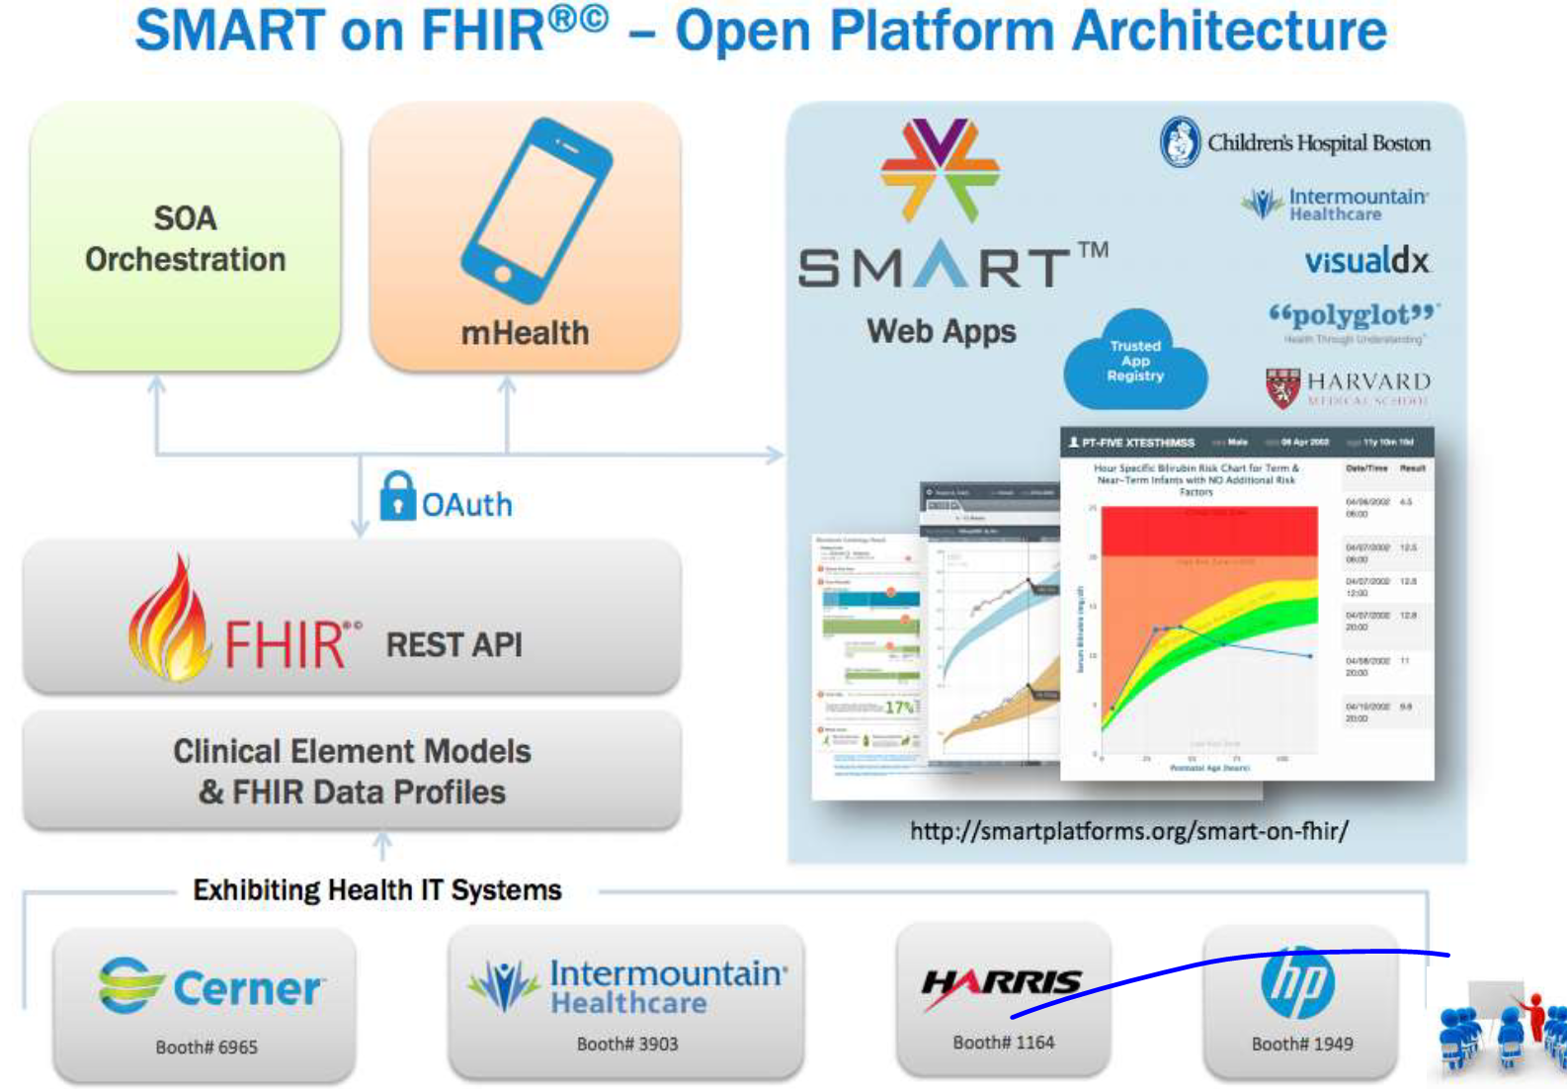
SMART on FHIR

Slide 29
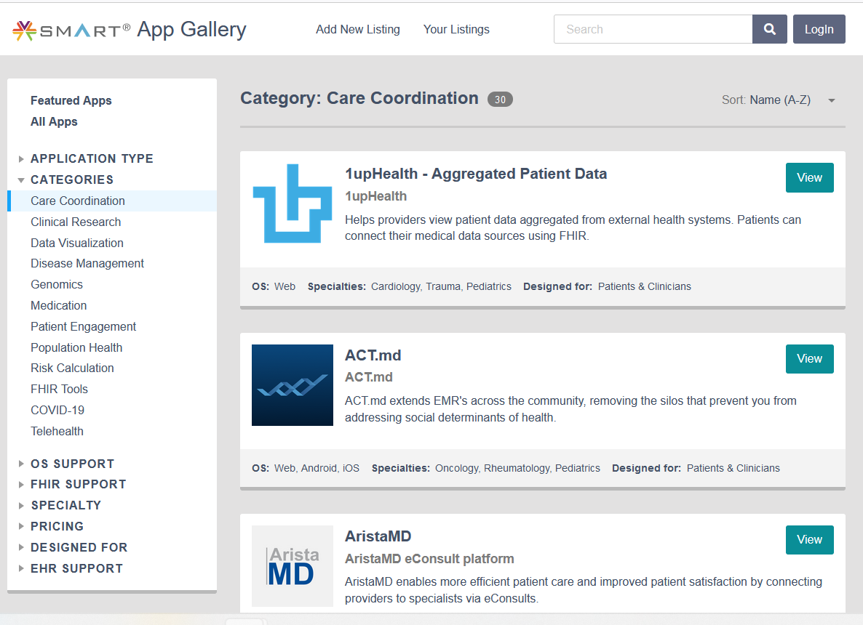
SMART on FHIR App Marketplaces
The SMART Health IT project maintains an App Gallery where developers can list their SMART on FHIR apps and others can try them out using a sandbox FHIR database
https://apps.smarthealthit.org/apps
Many EHR vendors maintain their own App Galleries where third party developed SMART on FHIR apps are listed that have been tested and certified with the vendor’s EHR system
Epic: https://apporchard.epic.com/
Cerner: https://code.cerner.com/apps
Allscripts: https://expo.allscripts.com/
and others …..

Slide 30
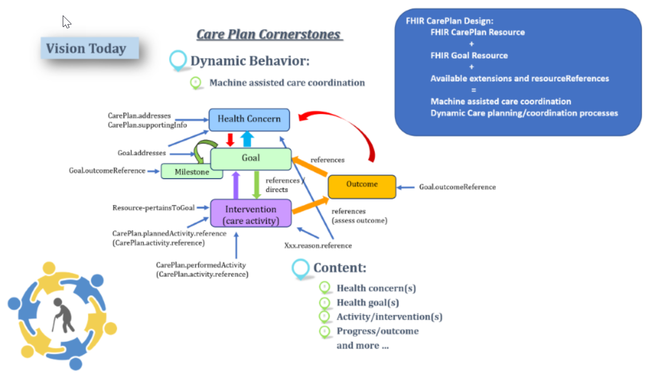
Representation of Care Plans in FHIR

Slide 31
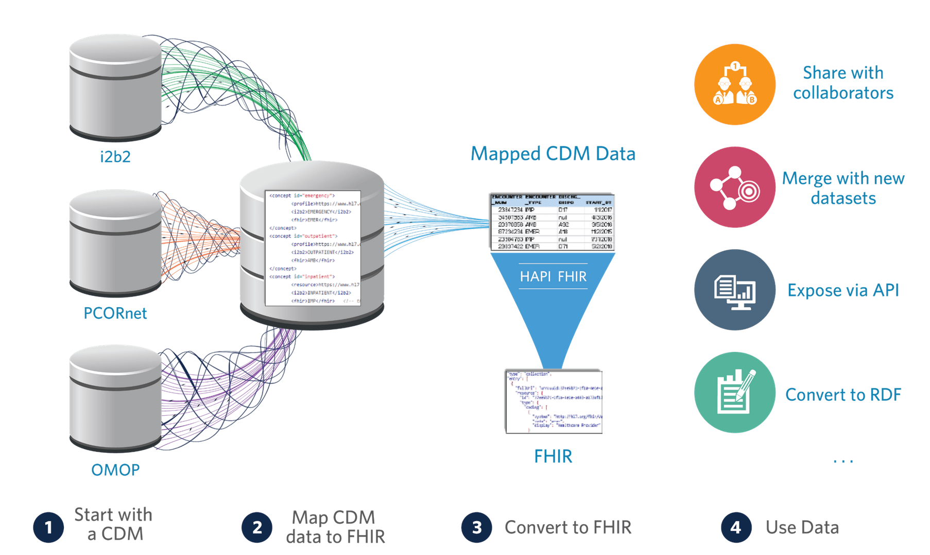

Slide 32
Reference
https://smarthealthit.org/
https://docs.smarthealthit.org/
https://apps.smarthealthit.org/

